Slide 1
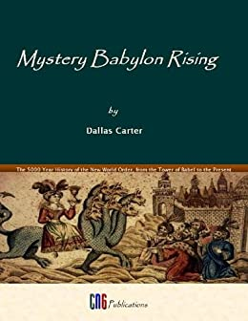
The Rise of Mystery Babylon
Presented By Dallas Carter on November 15, 2020

Slide 2
The Resurgence of Babylon
There is great unrest and angst today
People are wondering what is behind the seemingly unprecedented changes
Are we in the end times?
Is there is conspiracy?
The Bible teaches that there is such a conspiracy that reaches its apex in the endtimes

Slide 3
Mystery Babylon Rising
Mystery Babylon is religious at her core
Her base of power is economic
She uses propaganda to drunken the masses
She persecutes any who will not sleep with her or drink her wine

Slide 4
Mystery Babylon as a Religion
Mystery Babylon is rendered μυστήριον Βαβυλών (Musterion Babulon)
μυστήριον (Musterion) designates Babylon as a mystery religion
Mystery Religions promise secret knowledge to the initiated
    So he carried me away in the spirit into the wilderness: and I saw a woman sit upon a scarlet coloured beast, full of names of blasphemy, having seven heads and ten horns. And the woman was arrayed in purple and scarlet colour, and decked with gold and precious stones and pearls, having a golden cup in her hand full of abominations and filthiness of her fornication: And upon her forehead was a name written, MYSTERY, BABYLON THE GREAT, THE MOTHER OF HARLOTS AND ABOMINATIONS OF THE EARTH.
    -Revelation 17:3-5 KJV

Slide 5
Mystery Babylon as a Religion
Mystery Babylon view nature as the ultimate reality and is personified as the Mother Goddess
Mystery Babylon presents an evolutionary view of divinity where the divine nature is evolving cosmic forces
Mystery Babylon envisions the state as the apex of such evolution, personified as a king who is a consort of the so-called Great Mother.
The consummation of this relationship was thought to produce fruitfulness and prosperity - Heiros Gamos
Mystery Babylon seeks to exalt the state as god on earth as its eschaton or end-game
The religion of Mysteryu Babylon presumes that only selected individuals have the divine spark and that such knowledge was private

Slide 6
A Brief History of Mystery Babylon
Mystery Babylon began at the Tower of Babel
Gen 11:1-9 And the whole earth was of one language, and of one speech. And it came to pass, as they journeyed from the east, that they found a plain in the land of Shinar; and they dwelt there. And they said one to another, Go to, let us make brick, and burn them throughly. And they had brick for stone, and slime had they for morter. And they said, Go to, let us build us a city and a tower, whose top may reach unto heaven; and let us make us a name, lest we be scattered abroad upon the face of the whole earth. And the LORD came down to see the city and the tower, which the children of men builded...

Slide 7
A Brief History of Mystery Babylon
Mystery Babylon began at the Tower of Babel
...And the LORD said, Behold, the people is one, and they have all one language; and this they begin to do: and now nothing will be restrained from them, which they have imagined to do. Go to, let us go down, and there confound their language, that they may not understand one another's speech. So the LORD scattered them abroad from thence upon the face of all the earth: and they left off to build the city. Therefore is the name of it called Babel; because the LORD did there confound the language of all the earth: and from thence did the LORD scatter them abroad upon the face of all the earth.
-Genesis 11:1-9 KJV

Slide 8
A Brief History of Mystery Babylon
Mystery Babylon began at the Tower of Babel
Operatives of Babylon operated in numerous religions as people scattered into nations
Mystery Babylon surged in the ancient world when Alexander the Great conquered Babylon - starting a movement that appeared to be Hellenic ecumenism but was Babylonian in its core.
The First Great Awakening at Pentecost set back Mystery Babylon
Mystery Babylon survived in the Middle Ages primarily in the Islamic world

Slide 9
Mystery Babylon as a Religion
Resurged in modern times through Plethon, who brought Hermetic mysteries from the Byzantine Empire; and Hegel who was a pantheist who worshippped an idealized state as god on earth.Hegel believed god was the world spirit who was instantiated in the acts of states of “world-historical persons.” Hegel's thought had a profound influence on politics. Karl Marx (Marxism) and Giovanni Gentile (Fascism) were influenced by Hegel
Two early modern banking families, the Medicis and the Fuggers, were practitioners of Hermetic mysteries, opening the door for Mystery Babylon to access economic power.
The modern terms “New World Order” and “Deep State” refer to the contemporary forms of Mystery Babylon.
The modern end-game of Mystery Babylon is the Antichrist, who will claim to be god on earth.

Slide 10
Her base of power is economic
Mystery Babylon is religious at her core
    ...for thy merchants were the great men of the earth; for by thy sorceries were all nations deceived.
    -Revelation 18:23 KJV
Modern banking has occult roots via deMedicis, Fuggers, and Rothchilds
Massive concentration of power with which she seduces nations and kings. This seduction is how she controls governments

Slide 11
Concentration of power
Occupation | Number
Number of Legal Architects | 45662
Article 3 Federal Judges⁹⁸ | 874
Total State Judges⁹⁹ | 32,289.6
Number of Law Professors¹⁰⁰ | 12,498
Other Legal Professionals – attorneys¹⁰¹ | 507,000
Number of Businesses¹⁰² | 5,734,538
Number of Businesses employing 100 or more¹⁰³ | 99,009¹⁰⁴
Managers of Natural Sciences¹⁰⁵ | 43,060
Real estate1⁰⁶ | 159,700
Social Services and Religious workers1⁰⁷ | 1,861,750
Public School administrators¹⁰⁸ | 50,000
Police and Sheriff’s Patrol Officers¹⁰⁹ | 633,710
Editors¹¹⁰ | 110,010
Producers and Directors¹¹¹ | 78,060
Total | 3,399,148

Slide 12
She uses propaganda to drunken the masses
Mystery Babylon's propaganda is described as “the wine of her fornication.”
Concentration of media control.
Big Tech Censorship.
Shift towards gnostic epistemology

Slide 13
Propaganda as “the wine of her fornication.”
She seduces leaders of platforms so that they deceive their followers
        For all nations have drunk of the wine of the wrath of her fornication, and the kings of the earth have committed fornication with her, and the merchants of the earth are waxed rich through the abundance of her delicacies.
-Revelation 18:3 KJV
Due to the illicit love relationship to the harlot, their allegience is to her rather than the people group they are supposed to represent.
In turn they put out propaganda to their trusting followers

Slide 14
She uses propaganda to drunken the masses
Concentration of media control.
Big Tech Censorship.
Shift towards gnostic epistemology

Slide 15
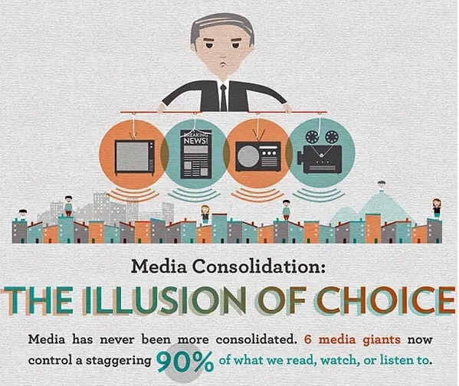
Concentration of media control
Six companies, with 232 total executives, control 90% of America's media market

Slide 16
Big Tech Censorship
There has been a clearly established pattern of discrimination against conservatives and Evangelicals
Numerous insiders have come out testifying that there is culture/policies of hostility to Conservatives and Evangelicals.
Section 230 of FCC regs gives social media giants a privileged position that allows them to cherry pick between publisher and platform.
  Publishers can moderate, but are subject to lawsuit for libel, etc
  Platforms are exempt from such lawsuit, but cannot moderate legal content
  Because they are “free,” There is no contract to enforce; they can violate their own terms at will
There are currently congressional hearings over Big Tech Censorship

Slide 17
Shift towards gnostic epistemology
There is a shift away rom public to private knowledge requiring privileged access
Science and other empirical fields are moving away from testing towards official consensus
Shift away from knowledge claimants having a burden to persuade the conscience to a burden on the conscience to put their beliefs in line with the “authorities” and the “experts.”
The automatc dismissal of “conspiracy” theories gives mainstream, offical theories special, gnostic status as they can no longer be challenged or subject to falsification tests.
Critical Race Theory leads to ethnic gnosticism where only the oppressed have private knowledge of their oppression. Who decides who is oppressed?

Slide 18
She persecutes the saints
Th use Repressive Tolerance
De-platforming and cancel culture
Hate Trump narrative used to argue that Evangelical Christian are dangerous “deplorables.”
All of this will be used as an argument for a one world state church to regulate religion - this will segway to the Antichrist.

Slide 19
Full marriage to Christ is the endgame
The marriage supper
  And I heard as it were the voice of a great multitude, and as the voice of many waters, and as the voice of mighty thunderings, saying, Alleluia: for the Lord God omnipotent reigneth. Let us be glad and rejoice, and give honour to him: for the marriage of the Lamb is come, and his wife hath made herself ready. And to her was granted that she should be arrayed in fine linen, clean and white: for the fine linen is the righteousness of saints.
  -Revelation 19:6-8 KJV

