Slide 1

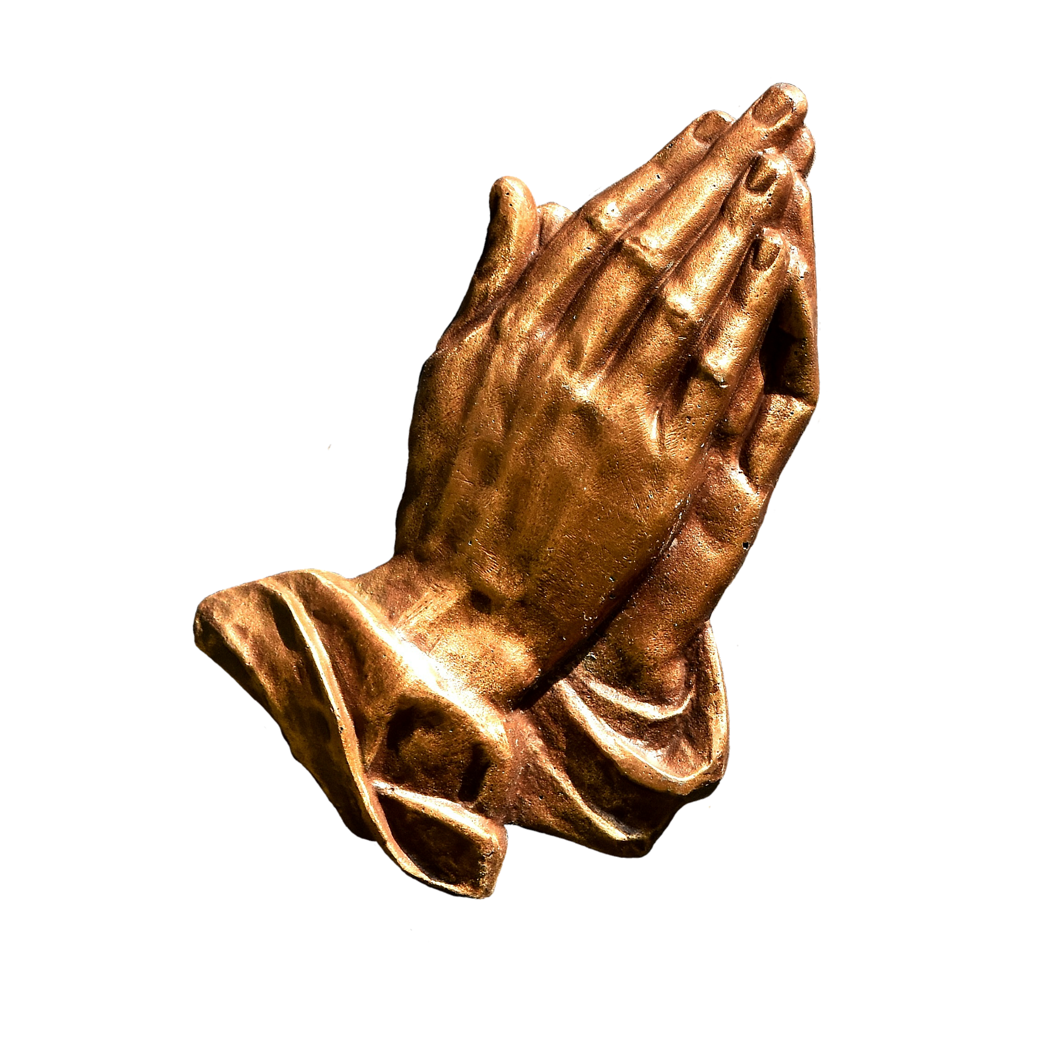
Praying with Power:Template for Revival
Presented By Dallas Carter on February 6, 2022

Slide 2
Solomon’s Temple Revival
Solomon calls a Sacred Assembly.
Music releases the Anointing
Solomon Confesses God’s Word
Solomon Prays to God to uphold the Kingdom
Solomon Asks God to attend to prayers made here
  Solomon Asks God to attend to prayers for Justice
  Solomon Asks God to attend to prayers for Deliverance
  Solomon Asks God to attend to prayers against famine
  Solomon Asks God to attend to prayers against pestilence
  Solomon Asks God to attend to prayers of God-fearing Gentiles
  Solomon Asks God to attend to prayers of just warfare
  Solomon Asks God to attend to prayers for Restoration
Solomon Asks God to attend to prayers made here
The Fire Fell!!!
This happened at the Feast of Tabernacles

Slide 3
Solomon’s Temple Revival
Solomon calls a Sacred Assembly
2 Chronicles 5:1-7
Thus all the work that Solomon made for the house of the LORD was finished: and Solomon brought in all the things that David his father had dedicated; and the silver, and the gold, and all the instruments, put he among the treasures of the house of God. Then Solomon assembled the elders of Israel, and all the heads of the tribes, the chief of the fathers of the children of Israel, unto Jerusalem, to bring up the ark of the covenant of the LORD out of the city of David, which is Zion...

Slide 4
Music releases the Anointing
2 Chronicles 5:11-14
And it came to pass, when the priests were come out of the holy place: (for all the priests that were present were sanctified, and did not then wait by course: Also the Levites which were the singers, all of them of Asaph, of Heman, of Jeduthun, with their sons and their brethren, being arrayed in white linen, having cymbals and psalteries and harps, stood at the east end of the altar, and with them an hundred and twenty priests sounding with trumpets:)...

Slide 5
Music releases the Anointing
...It came even to pass, as the trumpeters and singers were as one, to make one sound to be heard in praising and thanking the LORD; and when they lifted up their voice with the trumpets and cymbals and instruments of musick, and praised the LORD, saying, For he is good; for his mercy endureth for ever: that then the house was filled with a cloud, even the house of the LORD; So that the priests could not stand to minister by reason of the cloud: for the glory of the LORD had filled the house of God.
-2 Chronicles 5:11-14

Slide 6
Solomon Confesses God’s Word
2 Chronicles 6:4-11
And he said, Blessed be the LORD God of Israel, who hath with his hands fulfilled that which he spake with his mouth to my father David, saying, Since the day that I brought forth my people out of the land of Egypt I chose no city among all the tribes of Israel to build an house in, that my name might be there; neither chose I any man to be a ruler over my people Israel: But I have chosen Jerusalem, that my name might be there; and have chosen David to be over my people Israel. Now it was in the heart of David my father to build an house for the name of the LORD God of Israel...

Slide 7
Solomon Confesses God’s Word
...But the LORD said to David my father, Forasmuch as it was in thine heart to build an house for my name, thou didst well in that it was in thine heart: Notwithstanding thou shalt not build the house; but thy son which shall come forth out of thy loins, he shall build the house for my name. The LORD therefore hath performed his word that he hath spoken: for I am risen up in the room of David my father, and am set on the throne of Israel, as the LORD promised, and have built the house for the name of the LORD God of Israel. And in it have I put the ark, wherein is the covenant of the LORD, that he made with the children of Israel.
-2 Chronicles 6:4-11

Slide 8
Solomon Prays to God to uphold the Kingdom
2 Chronicles 6:12-17
And he stood before the altar of the LORD in the presence of all the congregation of Israel, and spread forth his hands: For Solomon had made a brasen scaffold, of five cubits long, and five cubits broad, and three cubits high, and had set it in the midst of the court: and upon it he stood, and kneeled down upon his knees before all the congregation of Israel, and spread forth his hands toward heaven, And said, O LORD God of Israel, there is no God like thee in the heaven, nor in the earth; which keepest covenant, and shewest mercy unto thy servants, that walk before thee with all their hearts:...

Slide 9
Solomon Prays to God to uphold the Kingdom
...Thou which hast kept with thy servant David my father that which thou hast promised him; and spakest with thy mouth, and hast fulfilled it with thine hand, as it is this day. Now therefore, O LORD God of Israel, keep with thy servant David my father that which thou hast promised him, saying, There shall not fail thee a man in my sight to sit upon the throne of Israel; yet so that thy children take heed to their way to walk in my law, as thou hast walked before me. Now then, O LORD God of Israel, let thy word be verified, which thou hast spoken unto thy servant David.
-2 Chronicles 6:12-17

Slide 10
Solomon Asks God to attend to prayers made here
But will God in very deed dwell with men on the earth? behold, heaven and the heaven of heavens cannot contain thee; how much less this house which I have built! Have respect therefore to the prayer of thy servant, and to his supplication, O LORD my God, to hearken unto the cry and the prayer which thy servant prayeth before thee: That thine eyes may be open upon this house day and night, upon the place whereof thou hast said that thou wouldest put thy name there; to hearken unto the prayer which thy servant prayeth toward this place. Hearken therefore unto the supplications of thy servant, and of thy people Israel, which they shall make toward this place: hear thou from thy dwelling place, even from heaven; and when thou hearest, forgive.
-2 Chronicles 6:18-21

Slide 11
Solomon Asks God to attend to prayers for Justice
If a man sin against his neighbour, and an oath be laid upon him to make him swear, and the oath come before thine altar in this house; Then hear thou from heaven, and do, and judge thy servants, by requiting the wicked, by recompensing his way upon his own head; and by justifying the righteous, by giving him according to his righteousness.
-2 Chronicles 6:22-23

Slide 12
Solomon Asks God to attend to prayers for Deliverance
And if thy people Israel be put to the worse before the enemy, because they have sinned against thee; and shall return and confess thy name, and pray and make supplication before thee in this house; Then hear thou from the heavens, and forgive the sin of thy people Israel, and bring them again unto the land which thou gavest to them and to their fathers.
-2 Chronicles 6:24-25

Slide 13
Solomon Asks God to attend to prayers against famine
When the heaven is shut up, and there is no rain, because they have sinned against thee; yet if they pray toward this place, and confess thy name, and turn from their sin, when thou dost afflict them; Then hear thou from heaven, and forgive the sin of thy servants, and of thy people Israel, when thou hast taught them the good way, wherein they should walk; and send rain upon thy land, which thou hast given unto thy people for an inheritance.
-2 Chronicles 6:26-27

Slide 14
Solomon Asks God to attend to prayers against pestilence
If there be dearth in the land, if there be pestilence, if there be blasting, or mildew, locusts, or caterpillers; if their enemies besiege them in the cities of their land; whatsoever sore or whatsoever sickness there be:
Then what prayer or what supplication soever shall be made of any man, or of all thy people Israel, when every one shall know his own sore and his own grief, and shall spread forth his hands in this house:
Then hear thou from heaven thy dwelling place, and forgive, and render unto every man according unto all his ways, whose heart thou knowest; (for thou only knowest the hearts of the children of men:) That they may fear thee, to walk in thy ways, so long as they live in the land which thou gavest unto our fathers.
-2 Chronicles 6:28-31

Slide 15
Solomon Asks God to attend to prayers of God-fearing Gentiles
Moreover concerning the stranger, which is not of thy people Israel, but is come from a far country for thy great name's sake, and thy mighty hand, and thy stretched out arm; if they come and pray in this house; Then hear thou from the heavens, even from thy dwelling place, and do according to all that the stranger calleth to thee for; that all people of the earth may know thy name, and fear thee, as doth thy people Israel, and may know that this house which I have built is called by thy name.
-2 Chronicles 6:32-33

Slide 16
Solomon Asks God to attend to prayers of just warfare
If thy people go out to war against their enemies by the way that thou shalt send them, and they pray unto thee toward this city which thou hast chosen, and the house which I have built for thy name; Then hear thou from the heavens their prayer and their supplication, and maintain their cause.
-2 Chronicles 6:34-35

Slide 17
Solomon Asks God to attend to prayers for Restoration
If they sin against thee, (for there is no man which sinneth not,) and thou be angry with them, and deliver them over before their enemies, and they carry them away captives unto a land far off or near; Yet if they bethink themselves in the land whither they are carried captive, and turn and pray unto thee in the land of their captivity, saying, We have sinned, we have done amiss, and have dealt wickedly; If they return to thee with all their heart and with all their soul in the land of their captivity, whither they have carried them captives, and pray toward their land, which thou gavest unto their fathers, and toward the city which thou hast chosen, and toward the house which I have built for thy name: Then hear thou from the heavens, even from thy dwelling place, their prayer and their supplications, and maintain their cause, and forgive thy people which have sinned against thee.
-2 Chronicles 6:36-39

Slide 18
Solomon Asks God to attend to prayers made here
Now, my God, let, I beseech thee, thine eyes be open, and let thine ears be attent unto the prayer that is made in this place. Now therefore arise, O LORD God, into thy resting place, thou, and the ark of thy strength: let thy priests, O LORD God, be clothed with salvation, and let thy saints rejoice in goodness. O LORD God, turn not away the face of thine anointed: remember the mercies of David thy servant.
-2 Chronicles 6:40-42

Slide 19
The Fire Fell!!!
Now when Solomon had made an end of praying, the fire came down from heaven, and consumed the burnt offering and the sacrifices; and the glory of the LORD filled the house. And the priests could not enter into the house of the LORD, because the glory of the LORD had filled the LORD'S house. And when all the children of Israel saw how the fire came down, and the glory of the LORD upon the house, they bowed themselves with their faces to the ground upon the pavement, and worshipped, and praised the LORD, saying, For he is good; for his mercy endureth for ever.
-2 Chronicles 7:1-3

Slide 20
This happened at the Feast of Tabernacles
Also at the same time Solomon kept the feast seven days, and all Israel with him, a very great congregation, from the entering in of Hamath unto the river of Egypt. And in the eighth day they made a solemn assembly: for they kept the dedication of the altar seven days, and the feast seven days. And on the three and twentieth day of the seventh month he sent the people away into their tents, glad and merry in heart for the goodness that the LORD had shewed unto David, and to Solomon, and to Israel his people.
-2 Chronicles 7:8-10

Slide 21
This happened at the Feast of Tabernacles
Also at the same time Solomon kept the feast seven days, and all Israel with him, a very great congregation, from the entering in of Hamath unto the river of Egypt. And in the eighth day they made a solemn assembly: for they kept the dedication of the altar seven days, and the feast seven days. And on the three and twentieth day of the seventh month he sent the people away into their tents, glad and merry in heart for the goodness that the LORD had shewed unto David, and to Solomon, and to Israel his people.
-2 Chronicles 7:8-10

Slide 22
Upon This Rock
Prayer in the Old Testament
Prayer in the New Testament
What to pray
Approaching God’s Court
Prayer formats
  ACTS Prayer
  The Lord’s Prayer

