Slide 1
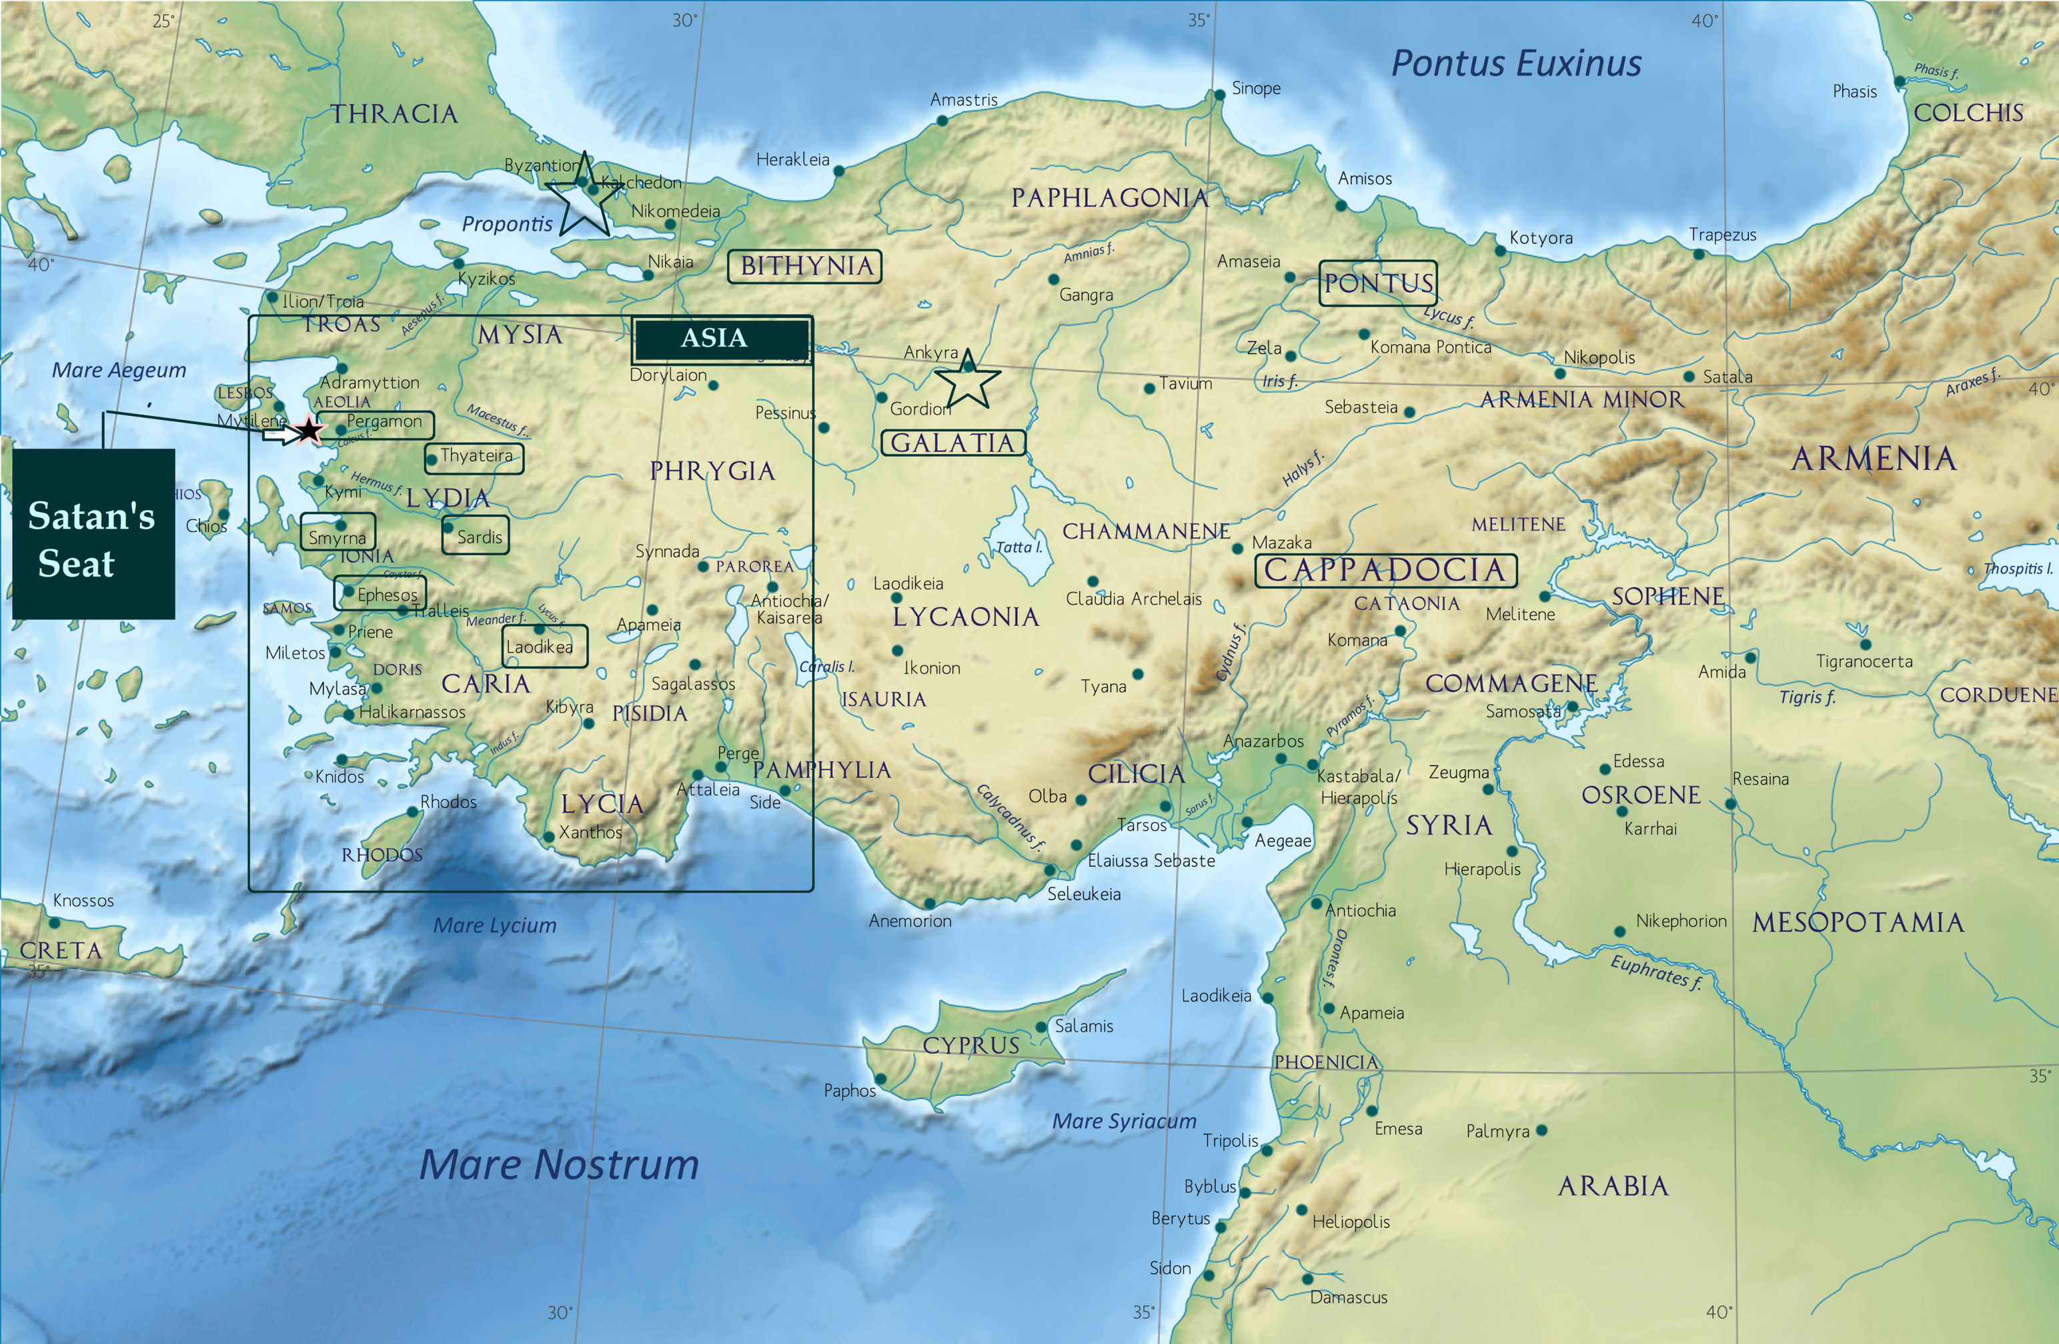
1 Peter 5
Presented By Dallas Carter on August 8, 2021

Slide 2

Elders as pilgrim leaders
The elders which are among you I exhort, who am also an elder, and a witness of the sufferings of Christ, and also a partaker of the glory that shall be revealed: Feed the flock of God which is among you, taking the oversight thereof, not by constraint, but willingly; not for filthy lucre, but of a ready mind; Neither as being lords over God's heritage, but being ensamples to the flock. And when the chief Shepherd shall appear, ye shall receive a crown of glory that fadeth not away.
-1 Peter 5:1-4

Slide 3
The example of a Good Pastor
Matthew 20:20-28 Then came to him the mother of Zebedee's children with her sons, worshipping him, and desiring a certain thing of him. - 21 And he said unto her, What wilt thou? She saith unto him, Grant that these my two sons may sit, the one on thy right hand, and the other on the left, in thy kingdom. - 22 But Jesus answered and said, Ye know not what ye ask. Are ye able to drink of the cup that I shall drink of, and to be baptized with the baptism that I am baptized with? They say unto him, We are able...

Slide 4
Elders as pilgrim leaders
... - 23 And he saith unto them, Ye shall drink indeed of my cup, and be baptized with the baptism that I am baptized with: but to sit on my right hand, and on my left, is not mine to give, but it shall be given to them for whom it is prepared of my Father. - 24 And when the ten heard it, they were moved with indignation against the two brethren. - 25 But Jesus called them unto him, and said, Ye know that the princes of the Gentiles exercise dominion over them, and they that are great exercise authority upon them. - 26 But it shall not be so among you: but whosoever will be great among you, let him be your minister; - 27 And whosoever will be chief among you, let him be your servant: - 28 Even as the Son of man came not to be ministered unto, but to minister, and to give his life a ransom for many.
-Matthew 20:20-28

Slide 5
Don’t be/follow Bad Shepherds
Ezekiel 34:1-10 And the word of the LORD came unto me, saying, - 2 Son of man, prophesy against the shepherds of Israel, prophesy, and say unto them, Thus saith the Lord GOD unto the shepherds; Woe be to the shepherds of Israel that do feed themselves! should not the shepherds feed the flocks? - 3 Ye eat the fat, and ye clothe you with the wool, ye kill them that are fed: but ye feed not the flock. - 4 The diseased have ye not strengthened, neither have ye healed that which was sick, neither have ye bound up that which was broken, neither have ye brought again that which was driven away, neither have ye sought that which was lost; but with force and with cruelty have ye ruled them. - 5 And they were scattered, because there is no shepherd: and they became meat to all the beasts of the field, when they were scattered...

Slide 6
Don’t be/follow Bad Shepherds
Ezekiel 34:1-10 ... - 6 My sheep wandered through all the mountains, and upon every high hill: yea, my flock was scattered upon all the face of the earth, and none did search or seek after them... - 7 Therefore, ye shepherds, hear the word of the LORD; - 8 As I live, saith the Lord GOD, surely because my flock became a prey, and my flock became meat to every beast of the field, because there was no shepherd, neither did my shepherds search for my flock, but the shepherds fed themselves, and fed not my flock; - 9 Therefore, O ye shepherds, hear the word of the LORD; - 10 Thus saith the Lord GOD; Behold, I am against the shepherds; and I will require my flock at their hand, and cause them to cease from feeding the flock; neither shall the shepherds feed themselves any more; for I will deliver my flock from their mouth, that they may not be meat for them.

Slide 7
Don’t be/follow Bad Shepherds
Matthew 23:1-12 Then spake Jesus to the multitude, and to his disciples, - 2 Saying, The scribes and the Pharisees sit in Moses' seat: - 3 All therefore whatsoever they bid you observe, that observe and do; but do not ye after their works: for they say, and do not. - 4 For they bind heavy burdens and grievous to be borne, and lay them on men's shoulders; but they themselves will not move them with one of their fingers. - 5 But all their works they do for to be seen of men: they make broad their phylacteries, and enlarge the borders of their garments, - 6 And love the uppermost rooms at feasts, and the chief seats in the synagogues, - 7 And greetings in the markets, and to be called of men, Rabbi, Rabbi. - 8 But be not ye called Rabbi: for one is your Master, even Christ; and all ye are brethren. - 9 And call no man your father upon the earth: for one is your Father, which is in heaven. - 10 Neither be ye called masters: for one is your Master, even Christ. - 11 But he that is greatest among you shall be your servant. - 12 And whosoever shall exalt himself shall be abased; and he that shall humble himself shall be exalted.

Slide 8
Humility to be the practice in the Church
Likewise, ye younger, submit yourselves unto the elder. Yea, all of you be subject one to another, and be clothed with humility: for God resisteth the proud, and giveth grace to the humble. Humble yourselves therefore under the mighty hand of God, that he may exalt you in due time: Casting all your care upon him; for he careth for you. Be sober, be vigilant; because your adversary the devil, as a roaring lion, walketh about, seeking whom he may devour: Whom resist stedfast in the faith, knowing that the same afflictions are accomplished in your brethren that are in the world.
-1 Peter 5:5-9
Pray without ceasing.
Pray in intercession

Slide 9
Closing Salutations
By Silvanus, a faithful brother unto you, as I suppose, I have written briefly, exhorting, and testifying that this is the true grace of God wherein ye stand. The church that is at Babylon, elected together with you, saluteth you; and so doth Marcus my son. Greet ye one another with a kiss of charity. Peace be with you all that are in Christ Jesus. Amen.
-1 Peter 5:12-14
Pray without ceasing.
Pray in intercession

Slide 10
Colossians Ch 4
Presented By Dallas Carter on August 8, 2021

