Slide 1
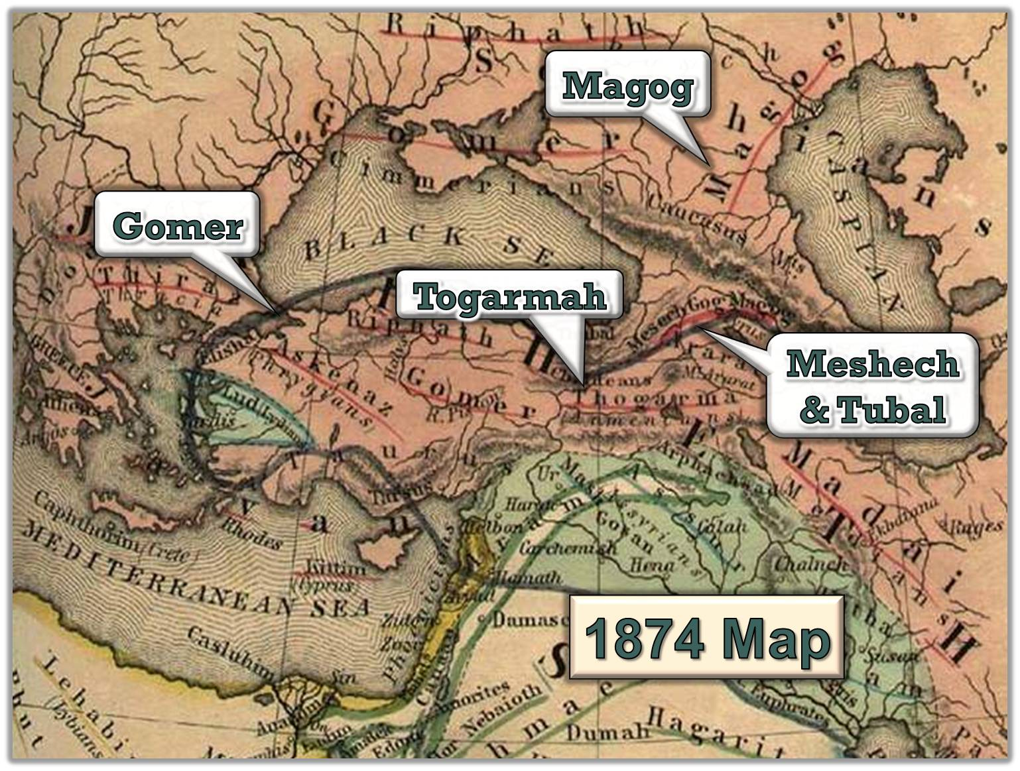
The Harlot Vs the Ten Horns
Presented By Dallas Carter on March 6, 2022

Slide 2
Ukrainian Flashpoint
The current conflict in Ukraine is a flash point of a much larger war.
On one side is the West and its allies
On the other is a the Russia-China- Middle East axis
Scripture cast this conflict as Mystery Babylon vs the Babylonian Empire

Slide 3
Mystery Babylon vs the Babylonian Empire
Entity | Mystery Babylon | Babylonian Empire
Genesis | Both began at the Tower of Babel
world-view | Both regard the state as god on earth
How the statolatry is set up | Papo-Caesarism | Caesaro-papism
How is power held | Loosely held centralization of power | Tighly held centralization of power
Basis of power | Socio-economic-ideological | Geo-political-military-pragmatic
How power is asserted | Covert projection of power | Overt projection of power
Significant religious influences in the schism | Roman Catholicism | Eastern Orthodoxy
Who’s Who | US-EU-Canada-Australia aka The West | Russia. China, North Korea, the Middle East

Slide 4
Caesaro-Papism vs Papo-Caesarism
Both Mystery Babylon and the Final Babylonian Empire started at Babel
The split began when George Gemistos Plethon fled the dying East Roma n Empire (Byzantine) when it fell to the Ottoman Turks
Plethon settled in Florence where he set up an occult school school to teach the occult mysteries of Babylon the leading thinkers of the Renaissance. He influenced the Medicis among the others.
Paganism was typically ceasaro-papist, with the state the leading player in the chuch-state marriage.
Islam and Eastern Orthodoxy also caesaro-papist.
Roman Catholocism, however, was papo-caesarist. The church dominated the state

Slide 5
The Triumph of Papocaesarism
Roman Catholicism’s papo-caesarism led to significant differences in how a New World Order gets set up.
The original first great Awakening in Acts disrupted the march of Mystery Babylon as a whole.
The Refomation and subsequent Awakening not only paused Mystery Babylon but altered the balance of power, making papo-Caesarism the dominant strain of Mystery Babylon
As revival fires cooled and Christianity gave way to Mystery Babylon, the papo-caesarist version of Babylon dominated the earth via the New World Order

Slide 6
The Fall of Mystery Babylon
And the angel said unto me, Wherefore didst thou marvel? I will tell thee the mystery of the woman, and of the beast that carrieth her, which hath the seven heads and ten horns. The beast that thou sawest was, and is not; and shall ascend out of the bottomless pit, and go into perdition: and they that dwell on the earth shall wonder, whose names were not written in the book of life from the foundation of the world, when they behold the beast that was, and is not, and yet is. And here is the mind which hath wisdom. The seven heads are seven mountains, on which the woman sitteth. And there are seven kings: five are fallen, and one is, and the other is not yet come; and when he cometh, he must continue a short space. And the beast that was, and is not, even he is the eighth, and is of the seven, and goeth into perdition.
-Revelation 17:7-11
Seven mountains are centralized collections of socio-economic power bases.
As the West is organized as such, these nations will fall with Mystery Babylon
Eight kings are different forms of Babylon

Slide 7
The Empires of Babylon
Paleo-Babylonian Empire
Assyrian Empire
Neo-Babylonian Empire
Persian Empire
Grecian Empire
These have fallen
Roman Empire (The one that is).
Ottoman Empire
The New World Order, with feet of iron mixed with clay, is here
The final Babylonian Empire ( Was, is not, and will be)

Slide 8
The rise of the ten horns
And the ten horns which thou sawest are ten kings, which have received no kingdom as yet; but receive power as kings one hour with the beast. These have one mind, and shall give their power and strength unto the beast. These shall make war with the Lamb, and the Lamb shall overcome them: for he is Lord of lords, and King of kings: and they that are with him are called, and chosen, and faithful. And he saith unto me, The waters which thou sawest, where the whore sitteth, are peoples, and multitudes, and nations, and tongues. And the ten horns which thou sawest upon the beast, these shall hate the whore, and shall make her desolate and naked, and shall eat her flesh, and burn her with fire. For God hath put in their hearts to fulfil his will, and to agree, and give their kingdom unto the beast, until the words of God shall be fulfilled. And the woman which thou sawest is that great city, which reigneth over the kings of the earth.
-Revelation 17:12-18

Slide 9
Who are the ten horns
They are nations who back a world leader who will lead the final version of the Babylonian empire
This will be organized like an empire.
It is at this place in history that Gog first enters the scene

Slide 11
The rise of the ten horns
And the word of the LORD came unto me, saying, Son of man, set thy face against Gog, the land of Magog, the chief prince of Meshech and Tubal, and prophesy against him, And say, Thus saith the Lord GOD; Behold, I am against thee, O Gog, the chief prince of Meshech and Tubal: And I will turn thee back, and put hooks into thy jaws, and I will bring thee forth, and all thine army, horses and horsemen, all of them clothed with all sorts of armour, even a great company with bucklers and shields, all of them handling swords: Persia, Ethiopia, and Libya with them; all of them with shield and helmet: Gomer, and all his bands; the house of Togarmah of the north quarters, and all his bands: and many people with thee.
-Ezekiel 38:1-6

Slide 12
Signs that Gog is the Antichrist
An earthquake so severe that a leveling of all of the world’smountains and cities occurs.
Great hailstones falling out of the sky
The gathering of armies from all over the earth
Raining down blood upon the earth, contaminating all waters
Inflicting pestilence – persistent sores
Scorching people with fire
Birds of carrion invited to feed on the dead bodies of men and
animals.

Slide 13
Signs that Gog is the Antichrist
An earthquake so severe that it levels all of the world’s mountains and
cities occurs.
Revelation 16:18-20 and there was a great earthquake, such as was not since men were upon the earth, so mighty an earthquake, and so great. AND THE GREAT CITY WAS DIVIDED INTO THREE PARTS, AND THE CITIES OF THE NATIONS FELL: and great Babylon came in remembrance before God, to give unto her the cup of the wine of the fierceness of his wrath. AND EVERY ISLAND FLED AWAY, AND THE MOUNTAINS WERE NOT FOUND. | Surely in that day there shall be a great shaking in the land of Israel; So that the fishes of the sea, and the fowls of the heaven, and the beasts of the field, and all creeping things that creep upon the earth, and all the men that are upon the face of the earth, shall shake at my presence, and the MOUNTAINS SHALL BE THROWN DOWN, AND THE STEEP PLACES SHALL FALL, AND EVERY WALL SHALL FALL TO THE GROUND Ezekiel 38:19-20

Slide 14
Signs that Gog is the Antichrist
An earthquake so severe that it levels all of the world’s mountains and
cities occurs.
...Surely in that day there shall be a great shaking in the land of Israel; So that the fishes of the sea, and the fowls of the heaven, and the beasts of the field, and all creeping things that creep upon the earth, and all the men that are upon the face of the earth, shall shake at my presence, and the MOUNTAINS SHALL BE THROWN DOWN, AND THE STEEP PLACES SHALL FALL, AND EVERY WALL SHALL FALL TO THE GROUND Revelation 16:18-20 | Surely in that day there shall be a great shaking in the land of Israel; So that the fishes of the sea, and the fowls of the heaven, and the beasts of the field, and all creeping things that creep upon the earth, and all the men that are upon the face of the earth, shall shake at my presence, and the MOUNTAINS SHALL BE THROWN DOWN, AND THE STEEP PLACES SHALL FALL, AND EVERY WALL SHALL FALL TO THE GROUND Ezekiel 38:19-20

Slide 15
Signs that Gog is the Antichrist
Great hailstones falling out of the sky
AND THERE FELL UPON MEN A GREAT HAIL OUT OF HEAVEN, EVERY STONE ABOUT THE WEIGHT OF A TALENT: and men blasphemed God because of the plague of the hail; for the plague thereof was exceeding great Revelation 16:21 | And I will plead against Him with PESTILENCE AND WITH BLOOD; And I will rain upon, and upon his bands, and upon the many people that are with him, an overflowing rain, and GREAT HAILSTONES, fire, and brimstone Ezekiel 38:22

Slide 16
Signs that Gog is the Antichrist
The gathering of armies from all over the earth
And I saw three unclean spirits like frogs come out of the mouth of AND I WILL CALL FOR A SWORD AGAINST HIM THROUGHOUT ALL the dragon, and out of the mouth of the beast, and out of the mouth of the false prophet. FOR THEY ARE THE SPIRITS OF DEVILS, WORKING MIRACLES, WHICH GO FORTH UNTO THE KINGS OF THE EARTH AND OF THE WHOLE WORLD, TO GATHER THEM TO THE BATTLE OF THAT GREAT DAY OF GOD ALMIGHTY Revelation 16:13-14 | And I will call for a sword against him throughout all my mountains, saith the Lord GOD: every man's sword shall be against his brother. Ezekiel 38:21 (God owns all mountains)

Slide 17
Signs that Gog is the Antichrist
Raining down blood upon the earth, contaminating all waters
AND THE SECOND ANGEL POURED OUT HIS VIAL UPON THE SEA; AND IT BECAME AS THE BLOOD OF A DEAD MAN: AND EVERY LIVING SOUL DIED IN THE SEA. And the third angel poured out his vial upon the rivers and fountains of waters; and they became BLOOD. And I heard the angel of the waters say, Thou art righteous, O Lord, which art, and wast, and shalt be, because thou hast judged thus. For they have shed the blood of saints and prophets, and thou hast given them blood to drink; for they are worthy. Revelation 16:3-6 | And I will plead against Him with PESTILENCE AND WITH BLOOD; And I will rain upon, and upon his bands, and upon the many people that are with him, an overflowing rain, and GREAT HAILSTONES, fire, and brimstone Ezekiel 38:22

Slide 18
Signs that Gog is the Antichrist
Inflicting pestilence – persistent sores
And the first went, and poured out his vial upon the earth; and there fell a noisome and grievous sore upon the men which had the mark of the beast, and upon them which worshipped his image. AND THE SECOND ANGEL POURED OUT HIS VIAL UPON THE SEA; AND IT BECAME AS THE BLOOD OF A DEAD MAN: AND EVERY LIVING SOUL DIED IN THE SEA. Revelation 16:2-3 | And I will plead against Him with PESTILENCE AND WITH BLOOD; And I will rain upon, and upon his bands, and upon the many people that are with him, an overflowing rain, and GREAT HAILSTONES, fire, and brimstone Ezekiel 38:22

Slide 19
Signs that Gog is the Antichrist
Scorching people with fire
And the fourth angel poured out his vial upon the sun; and power was given unto him to scorch men with fire… Revelation 16:8 | And I will plead against Him with PESTILENCE AND WITH BLOOD; And I will rain upon, and upon his bands, and upon the many people that are with him, an overflowing rain, and GREAT HAILSTONES, fire, and brimstone Ezekiel 38:22

Slide 20
Signs that Gog is the Antichrist
Birds of Carrion feeding upon the flesh of the militaries
And I saw an angel standing in the sun; and he cried with a loud voice, saying to all the fowls that fly in the midst of heaven, COME AND GATHER YOURSELVES TOGETHER UNTO THE SUPPER OF THE GREAT GOD; THAT YE MAY EAT THE FLESH OF KINGS, AND THE FLESH OF CAPTAINS, AND THE FLESH OF MIGHTY MEN, and the flesh of horses, and of them that sit on them, and the flesh of all men, both free and bond, both small and great Revelation 19:17-18 | And I will plead against Him with PESTILENCE AND WITH BLOOD; And I will rain upon, and upon his bands, and upon the many people that are with him, an overflowing rain, and GREAT HAILSTONES, fire, and brimstone Ezekiel 39:17-19

Slide 21
The Harlot Vs the Ten Horns
Presented By Dallas Carter on March 6, 2022

