Slide 1
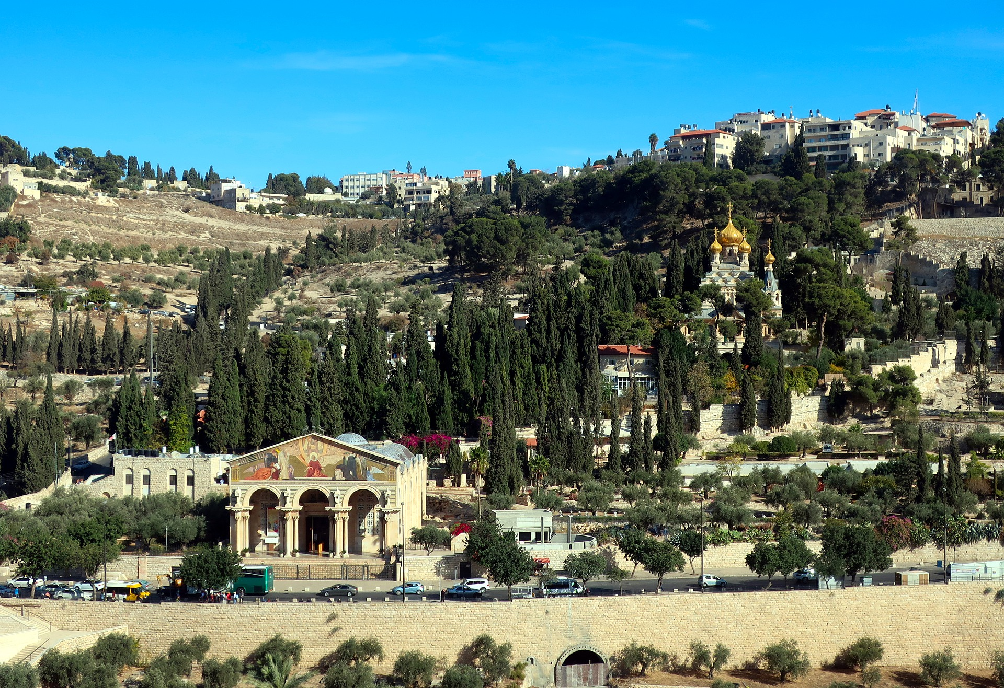
City On A Hill
Presented By Dallas Carter on April 10, 2022

Slide 2

This City on a Hill not based on carnal power
Matthew 5:9 - 18
Blessed are the peacemakers: for they shall be called the children of God. Blessed are they which are persecuted for righteousness' sake: for theirs is the kingdom of heaven. Blessed are ye, when men shall revile you, and persecute you, and shall say all manner of evil against you falsely, for my sake. Rejoice, and be exceeding glad: for great is your reward in heaven: for so persecuted they the prophets which were before you. Ye are the salt of the earth: but if the salt have lost his savour, wherewith shall it be salted? it is thenceforth good for nothing, but to be cast out, and to be trodden under foot of men..

Slide 3
The Church as the City on a Hill
Matthew 5:9 - 18
...Ye are the light of the world. A city that is set on an hill cannot be hid. Neither do men light a candle, and put it under a bushel, but on a candlestick; and it giveth light unto all that are in the house. Let your light so shine before men, that they may see your good works, and glorify your Father which is in heaven...

Slide 4
Neither God’s law nor reign abolished by Grace
Think not that I am come to destroy the law, or the prophets: I am not come to destroy, but to fulfil. For verily I say unto you, Till heaven and earth pass, one jot or one tittle shall in no wise pass from the law, till all be fulfilled.
-Matthew 5:9 - 18

Slide 5
Every City has an Ekklesia
ἐκκλησία (G1577)
ekklēsia (ek-klay-see'-ah)
From a compound of G1537 and a derivative of G2564; a calling out, that is, (concretely) a popular meeting, especially a religious congregation (Jewish synagogue, or Christian community of members on earth or saints in heaven or both): - assembly, church

Slide 6
Every City has an Ekklesia
In Greek culture an ekklesia was a legally constituted body.
It was used in reference to town meeting in cities such as Athens.
In the New Testament it was used almost exclusively in reference to the Church or churches.
The term as never used in reference to Jewish or pagan houses worship
The term was used only twice in the New Testament to refer to a legally constituted civil body ( both times in Acts 19:25-39).

Slide 7
Ekklesia as a fellowship of Kings and Priests
Ye have seen what I did unto the Egyptians, and how I bare you on eagles' wings, and brought you unto myself. Now therefore, if ye will obey my voice indeed, and keep my covenant, then ye shall be a peculiar treasure unto me above all people: for all the earth is mine: And ye shall be unto me a kingdom of priests, and an holy nation. These are the words which thou shalt speak unto the children of Israel.
-Exodus 19:4 - 6

Slide 8
Ekklesia as a fellowship of Kings and Priests
But ye are a chosen generation, a royal priesthood, an holy nation, a peculiar people; that ye should shew forth the praises of him who hath called you out of darkness into his marvellous light: -1 Peter 2:9

Slide 9
Ekklesia as a fellowship of Kings and Priests
And hath made us kings and priests unto God and his Father; to him be glory and dominion for ever and ever. Amen...
...And I beheld, and, lo, in the midst of the throne and of the four beasts, and in the midst of the elders, stood a Lamb as it had been slain, having seven horns and seven eyes, which are the seven Spirits of God sent forth into all the earth. And he came and took the book out of the right hand of him that sat upon the throne. And when he had taken the book, the four beasts and four and twenty elders fell down before the Lamb, having every one of them harps, and golden vials full of odours, which are the prayers of saints. And they sung a new song, saying, Thou art worthy to take the book, and to open the seals thereof: for thou wast slain, and hast redeemed us to God by thy blood out of every kindred, and tongue, and people, and nation; And hast made us unto our God kings and priests: and we shall reign on the earth.
-Revelation 1:6, 5:6 - 9

Slide 10
The Heavenly/Earthly mandate of the Ekklesia
The Church (Ekkesia) was not instructed to seize earthly power by carnal means.
However
The Church (Ekkesia) was instructed to take her place before God’s throne (Revelation 1:6, 5:6 - 9).
The Church (Ekkesia) was instructed to be a parallel City on a Hill.

Slide 11
The Heavenly/Earthly mandate of the Ekklesia
The Church (Ekkesia) was instructed to take her place before God’s throne (Revelation 1:6, 5:6 - 9).
Language etymologicaly related to ekkesia is used to reference the holy convocations of Leviticus 23
(H4744) miqrâ' (mik-raw') From H7121; something called out, that is, a public meeting (the act, the persons, or the palce); also a rehearsal: - assembly, calling, convocation, reading. | G2822 κλητός klētos klay-tos' From the same as G2821; invited, that is, appointed, or (specifically) a saint: - called. Total KJV occurrences: 11

Slide 12
The Sacred Assembly of Joel
Blow the trumpet in Zion, sanctify a fast, call a solemn assembly: Gather the people, sanctify the congregation, assemble the elders, gather the children, and those that suck the breasts: let the bridegroom go forth of his chamber, and the bride out of her closet. Let the priests, the ministers of the LORD, weep between the porch and the altar, and let them say, Spare thy people, O LORD, and give not thine heritage to reproach, that the heathen should rule over them: wherefore should they say among the people, Where is their God?
-Joel 2:15-17
G4863 “Gather” the people συνάγω sunagō soon-ag'-o From G4862 and G71; to lead together, that is, collect or convene; specifically to entertain (hospitably): - + accompany, assemble (selves, together), bestow, come together, gather (selves together, up, together), lead into, resort, take in. Total KJV occurrences: 62 | G1577 “Assemble” the elders ἐκκλησία ekklēsia ek-klay-see'-ah From a compound of G1537 and a derivative of G2564; a calling out, that is, (concretely) a popular meeting, especially a religious congregation (Jewish synagogue, or Christian community of members on earth or saints in heaven or both): - assembly, church. Total KJV occurrences: 115

Slide 13
The Parallel Polis as the City on a Hill
The parallel polis was a concept developed in Eastern Europe by Vaclav Benda and Vaclav Havel.
  Benda wrote Parallel Polis
  Havel wrote The Power of the Powerless, went on to become the President of the Czech Republic
  The Benedict option by Rod Dreher also relavant.
They sought to create a parallel society that existed outside of the Communist system.
  Avoided direct confrontation with the ruling system.
  Operated parallel
  Sought to address the full orbit of life
  The Kingship of Jesus Christ was not questioned

Slide 14
What the Parallel Polis today might look like
The parallel polis involves alternative communication and information flow systems.
The parallel polis involves alternative financial instruments (crypto and barter).
The parallel polis involves alternative business systems.
The parallel polis involves alternative cultural institutions.
The parallel polis involves separation from worldly religious systems, with churches and believers seeking God in sacred assembly.

Slide 15
City On A Hill
Presented By Dallas Carter on April 10, 2022

