Slide 1
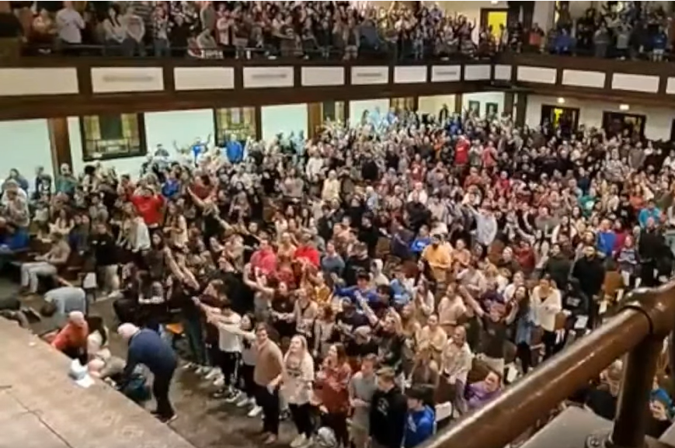
Revival Comes to Asbury
Presented By Dallas Carter on February 19, 2023

Slide 2

2023 Asbury Revival
The 2023 Asbury Revival began at 10A , February 8, 2023 during a student-led prayer meeting at the chapel.
There are reports that prayers for revial were offered antecedent to the revival
After a message on prayer and repentance by a student, an outpouring of the Holy Spirit kept students there and began to draw others to the meeting
Why did this happen, and where is it going?

Slide 3
The Asbury Revival began as a Sacred Assembly
Joe 2:12-17 Therefore also now, saith the LORD, turn ye even to me with all your heart, and with fasting, and with weeping, and with mourning: (13) And rend your heart, and not your garments, and turn unto the LORD your God: for he is gracious and merciful, slow to anger, and of great kindness, and repenteth him of the evil. (14) Who knoweth if he will return and repent, and leave a blessing behind him; even a meat offering and a drink offering unto the LORD your God? (15) Blow the trumpet in Zion, sanctify a fast, call a solemn assembly: (16) Gather the people, sanctify the congregation, assemble the elders, gather the children, and those that suck the breasts: let the bridegroom go forth of his chamber, and the bride out of her closet. (17) Let the priests, the ministers of the LORD, weep between the porch and the altar, and let them say, Spare thy people, O LORD, and give not thine heritage to reproach, that the heathen should rule over them: wherefore should they say among the people, Where is their God?

Slide 4
Outpourings Happen at Sacred Assemblies
Joe 2:28-32 And it shall come to pass afterward, that I will pour out my spirit upon all flesh; and your sons and your daughters shall prophesy, your old men shall dream dreams, your young men shall see visions: (29) And also upon the servants and upon the handmaids in those days will I pour out my spirit. (30) And I will shew wonders in the heavens and in the earth, blood, and fire, and pillars of smoke. (31) The sun shall be turned into darkness, and the moon into blood, before the great and the terrible day of the LORD come. (32) And it shall come to pass, that whosoever shall call on the name of the LORD shall be delivered: for in mount Zion and in Jerusalem shall be deliverance, as the LORD hath said, and in the remnant whom the LORD shall call.

Slide 5
Outpourings Happen at Sacred Assemblies
Act 2:14-21 But Peter, standing up with the eleven, lifted up his voice, and said unto them, Ye men of Judaea, and all ye that dwell at Jerusalem, be this known unto you, and hearken to my words: (15) For these are not drunken, as ye suppose, seeing it is but the third hour of the day. (16) But this is that which was spoken by the prophet Joel; (17) And it shall come to pass in the last days, saith God, I will pour out of my Spirit upon all flesh: and your sons and your daughters shall prophesy, and your young men shall see visions, and your old men shall dream dreams: (18) And on my servants and on my handmaidens I will pour out in those days of my Spirit; and they shall prophesy: (19) And I will shew wonders in heaven above, and signs in the earth beneath; blood, and fire, and vapour of smoke: (20) The sun shall be turned into darkness, and the moon into blood, before that great and notable day of the Lord come: (21) And it shall come to pass, that whosoever shall call on the name of the Lord shall be saved.

Slide 6
Outpourings Happen at Sacred Assemblies
Dedication of Solomon’s Temple (2 Chr 5-7)
The Jerusalem Revival ( 2 + 40 + 7 = 49, eighth day Sacred Assembly
The 100 Year Prayer Meeting (August 5-13, 1727)
The Kentucky Revival/Cane Ridge (August 6-13, 1801)
Azusa Street (April 6-12, 1906)
The Asbury Revival 2023 seems to be following this pattern

Slide 7
Anatomy of a Great Awakening
Intercessory Prayer leading up to Revival Event
Outpouring, which are spontaneous and decentralized
  Spontaneous and decentralized - unscripted and unmanipulated.
  Spontaneous and decentralized events unlikely to be products of mere human machination and desire
Is it Public?
  No - It dies when event peters out - the end (The fate of most revivals)
  Yes- Does it go viral?
    No - It dies when fire cools down at ground zero - individual embers elsewhere
    Yes -
      At this point a revival can be called a Great Awakening
      The method through which the fire is contained in the resulting movement determines the destiny of the awakening

Slide 8
Historically, Outpourings Happen at Sacred Assemblies
The Jerusalem Revival Planted churches all over the then known world
The 100 Year Prayer Meeting founded Evangelicalism and planted many churches - transformed others
The Kentucky Revival/Cane Ridge Established Christian Churches / Churc hes of Christ and planted many churches
The Moody Revivals transformed many churches and educational centers
Azusa Street Established Pentecostalism and planted many churches and transformed others
The Jesus Revolution both trsnformed and planted churches and other institutions

Slide 9
Azusa Awakening Almost Failed
Is it Public?
  No - It dies when event peters out - the end (The fate of most revivals)
  Yes - Does it go viral?
    No - It dies when fire cools down in locale - individual embers elsewhere
    Yes -
      There was competition/ infighting among leaders over which “private kingdom” would manifest the kigdom of God
      There was racism which created divisions between white and black Pentecostals.
      Azusa was done within 3 years and closed within 10 years of the revival

Slide 10
Brownsville - The Almost Awakening
Is it Public?
  No - It dies when event peters out - the end (The fate of most revivals)
  Yes - Does it go viral?
    No - It dies when fire cools down in locale - individual embers elsewhere
      There was an unhealthy fixation on signs and wonders
      There was unhealthy fixation on celebrities such as Rodney Howard-Browne
      The revival failed to reproduce on a mass scale
    Yes -

Slide 11
Will Asbury 2023 Become an Awakening?
Intercessory Prayer leading up to Revival Event
Outpouring, which are spontaneous and decentralized
  Spontaneous and decentralized - unscripted and unmanipulated.
  Spontaneous and decentralized events unlikely to be products of mere human machination and desire
Is it Public?
  No - It dies when event peters out - the end (The fate of most revivals)
  Yes - Does it go viral?
    No - It dies when fire cools down in locale - individual embers elsewhere
    Yes - Maybe?
      Does not seem to be a fixation on signs, wonders or personality.
      Human agendas and authority have not taken center stage.
      The groundwork is being laid to contain the fire into sustainable forms. What does this look like?

Slide 12
Asbury Revival 2023 Boundaries
The revival began on February 8, 2023 in a relatively decentralized fashion.
The following week there were numerous live videos of footage from the revival.
University official began communications at the event to set up rules for “housekeeping.”
February 14, 2023 University officials began to discourage the use of mobile devices to take live video citing privacy and anointing flow issues.
People were directed to approved feeds to watch live video

Slide 13
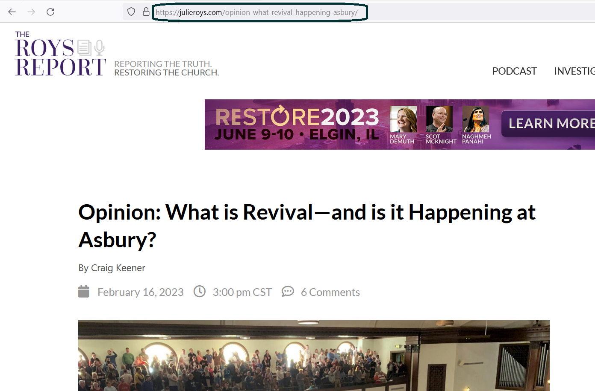

Slide 14
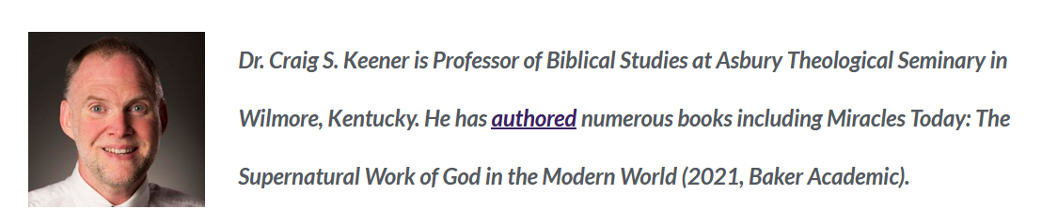
Who is Craig Keener

Slide 15
Keener’s take on Asbury Revival leadership
When I first visited Asbury Seminary to interview for a position in late 2010, I peeked into the university’s vacant auditorium. My eyes fell on the words emblazoned indelibly on the high, back wall of the sanctuary, “Holiness to the Lord.” At that moment, I felt a wave of the Spirit, like some special vestige remained from the earlier outpourings. But despite the currently filled auditoriums, it’s not about the place. It’s about holiness to the Lord.

Slide 16
Keener’s take on Asbury Revival leadership
Any reader of The Roys Report, Christianity Today or even secular media knows that a lot goes on in the name of Christianity that isn’t very Christian. The same is true in the history of revivals. God is God, but people are still people. One generation’s unique behavior during some revival can become the next generation’s tradition—and the following generation’s legalism. Some claims of revival are attempts to stir up emotion or create hype. And those who want a name for themselves often hijack movements that God initiates among the lowly.

Slide 17
Keener’s take on Asbury Revival leadership
It’s no surprise, then, that there are threats to the integrity of what is happening at Asbury. Some may come for hype or to seek attention for themselves, though hopefully they will leave with something different.
Administrators, campus ministry staff, and student leaders have been working overtime, sometimes on little sleep, trying to guard the movement’s integrity and focus. The leaders don’t want the focus to be about them or about Asbury. When President Kevin Brown addressed the assembly on Saturday evening, he prefaced his powerful comments by indicating that he was almost afraid to speak, lest he interrupt the holiness of God moving among the students.

Slide 18
Keener’s take on Asbury Revival leadership
And that is the correct posture to take because this is not about us, but about Him and His holiness. He alone is worthy of honor. He has made his presence felt. And in his presence, no flesh may boast.

Slide 19
Leadership Hijacking/killing Revival
The leadership approach at Asbury was minimalist, asserting itself only for basic housekeeping and neutralization of threats to the revival.
The number one revival killer is Church leaders who hijack or kill revivals
  Todd Bentley and others sought to hijack Asbury Revival 2023
  I (Pastor Dallas) have witnessed numerous local revivals due to church leadership hijacking and killing the move of God.
  There are leaders who openly oppose the revival, spewing slanderous/libelous accusations.
The leadership has sought to stir people to draw close to God, and then use their own gifts.

Slide 20
Some Concluding Thoughts
The leadership has sought to stir people to draw close to God, and then use their own gifts.
They have actively tried to dissuade people to idolizing the building or Asbury or celebrity preachers and focus on Christ.
They are preaching repentance and holiness to the Lord without using jargon (Changing priorities, laying aside agendas, changing how one thinks)
They are referencing gospel topics in a manner appropriate to the format or a payer and praise meeting.
Exigetically speaking, Asbury Revival 2023 has the potential to be the initial fire of the Final Great Awakening

Slide 21
Revival Comes to Asbury
Presented By Dallas Carter on February 19, 2023

