Slide 1
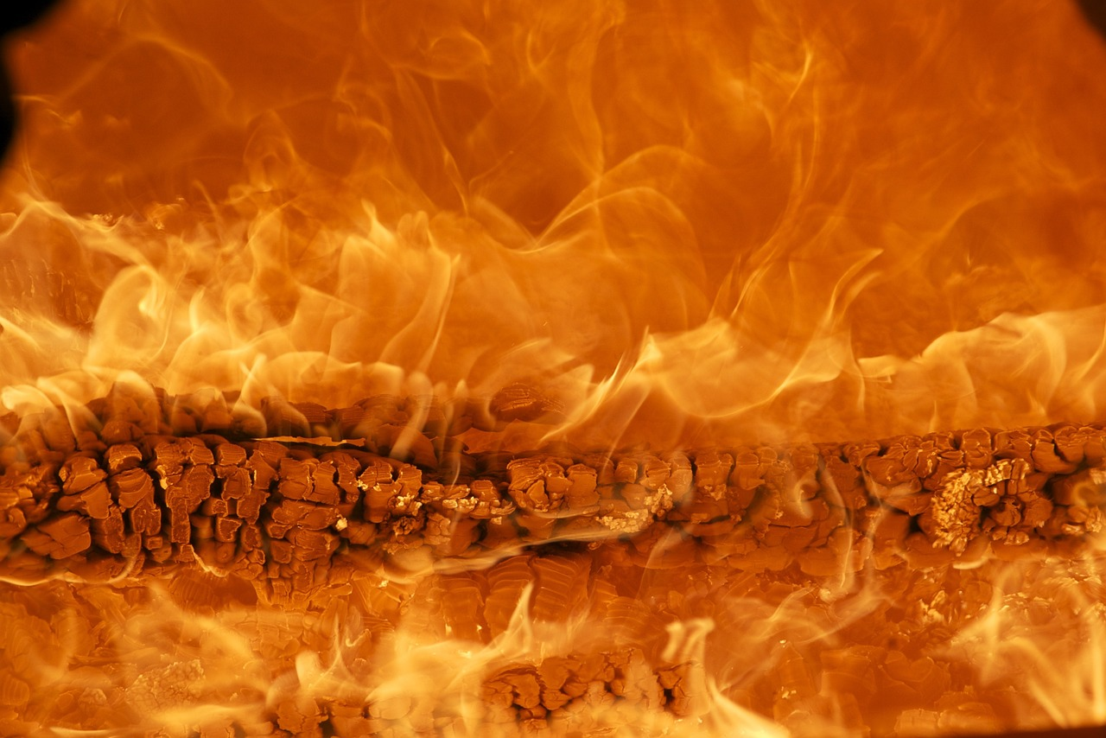
Memento Mori

Slide 2
Memento Mori
Remember, You MUST Die!!!

Slide 3
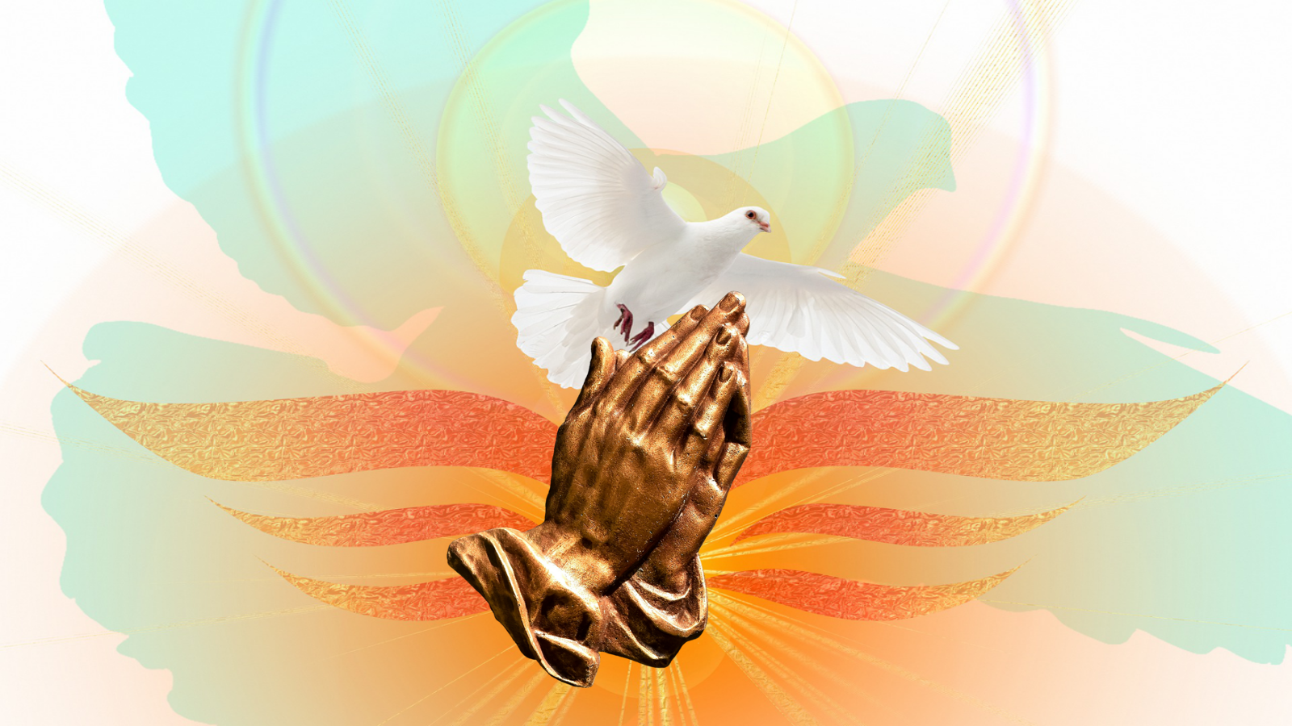
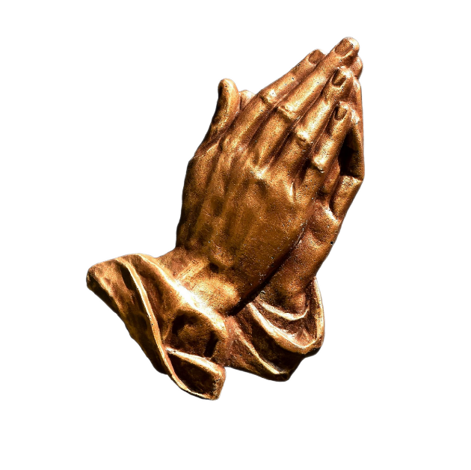

Slide 4

Appointed for Death
Heb 9:27-28 And as it is appointed for men to die once, but after this the judgment, (28) so Christ was offered once to bear the sins of many. To those who eagerly wait for Him He will appear a second time, apart from sin, for salvation.

